Slide 1
Time for Change: How Clocks Break UWB Secure Ranging
32nd USENIX Security Symposium
August 9–11, 2023 • Boston, MA, USA
중견 세미나
Nov. 5, 2023
Hoorin Park
Assistant Professor
Department of Information Security
Seoul Women’s University
hrpark@swu.ac.kr

Slide 2
Authors
Claudio Anliker
Ph.D. student in System Security Group, ETH Zurich
Publications
Patrick Leu, Giovanni Camurati, Alexander Heinrich, Marc Roeschlin, Claudio Anliker, Matthias Hollick, Srdjan Capkun, Jiska Classen, Ghost Peak: Practical Distance Reduction Attacks Against HRP UWB Ranging. USENIX Security Symposium 2022: 1343-1359

Slide 3
Authors
Giovanni Camurati
Postdoctoral Researcher, ETH Zurich
Ph.D. from EURECOM
Superviser: Aurélien Francillon
Ph.D. from Sorbonne Univ. and MS from Politecnico di Torino
Publications
Giovanni Camurati, Matteo Dell'Amico, François-​Xavier Standaert, “MCRank: Monte Carlo Key Rank Estimation for Side-​Channel Security Evaluations,” in IACR Transactions on Cryptographic Hardware and Embedded Systems (CHES) 2023
Giovanni Camurati, Aurélien Francillon, Screaming Channels, in Jajodia, S., Samarati, P., Yung, M. (eds) Encyclopedia of Cryptography, Security and Privacy. Springer, Berlin, Heidelberg.
Camurati G, Francillon A, Standaert F (2020) Understanding screaming channels: from a detailed analysis to improved attacks. IACR Trans Cryptogr Hardw Embed Syst 2020(3):358–401.
Camurati G, Poeplau S, Muench M, Hayes T, Francillon A (2018) Screaming channels: when electromagnetic side channels meet radio transceivers. In: Lie D, Mannan M, Backes M, Wang X (eds) Proceedings of the 2018 ACM SIGSAC Conference on Computer and Communications Security, CCS 2018, Toronto, 15–19 Oct 2018. ACM, pp 163–177.
G. Camurati and A. Francillon, "Noise-SDR: Arbitrary Modulation of Electromagnetic Noise from Unprivileged Software and Its Impact on Emission Security," 2022 IEEE Symposium on Security and Privacy (SP), San Francisco, CA, USA, 2022, pp. 1193-1210, doi: 10.1109/SP46214.2022.9833767.

Slide 4
Authors
Srdjan Capkun
Professor, Department of Computer Science, ETH Zurich
Ph.D. from EPFL in 2004 (advised by Jean-Pierre Hubaux)
Diplôme d'Ingénieur in EECS from University of Split in 1998
Publications
Marc Roeschlin, Giovanni Camurati, Pascal Brunner, Mridula Singh, Srdjan Capkun, “EdgeTDC: On the Security of Time Difference of Arrival Measurements in CAN Bus Systems,” in Network and Distributed System Security Symposium (NDSS) 2023
Friederike Groschupp, Mark Kuhne, Moritz Schneider, Ivan Puddu, Shweta Shinde, Srdjan Capkun, “It’s TEEtime: Bringing User Sovereignty to Smartphones,” https://arxiv.org/abs/2211.05206, 2022
Martin Kotuliak, Simon Erni, Patrick Leu, Marc Röschlin, Srdjan Čapkun, “LTrack: Stealthy Tracking of Mobile Phones in LTE,” in USENIX Security 2022
Karl Wüst, Kari Kostiainen, Noah Delius, Srdjan Capkun, “Platypus: A Central Bank Digital Currency with Unlinkable Transactions and Privacy Preserving Regulation, In ACM Conference on Computer and Communications Security (CCS), 2022
Ivan Puddu, Moritz Schneider, Miro Haller, Srdjan Čapkun, “Frontal Attack: Leaking Control-​Flow in SGX via the CPU Frontend,” in USENIX Security 2021

Slide 5
Authors
Srdjan Capkun
Publications (Pre-ETH)
S. Capkun, M. Cagalj, M. Srivastava, “Securing Localization With Hidden and Mobile Base Stations,” in Proceedings of IEEE INFOCOM 2006
S. Capkun, J. P. Hubaux, “Secure positioning in wireless networks,” IEEE Journal on Selected Areas in Communications (JSAC): Special Issue on Security in Wireless Ad Hoc Networks, February 2006.
M. Felegyhazi, S. Capkun, J. P. Hubaux, “SOWER: Self-Organizing Wireless Network for Messaging,” In Proceedings of the 2nd ACM International Workshop on Wireless Mobile Applications and Services on WLAN Hotspots (WMASH) 2004.
J. P. Hubaux, S. Capkun, J.Luo, “The Security and Privacy of Smart Vehicles,” IEEE Security & Privacy (May-June 2004).
L. Buttyán, J. P. Hubaux and S. Capkun, “A Formal Analysis of Syverson`s Rational Exchange Protocol,” Journal of Computer Security (2004).
Srdjan Capkun, Jean-Pierre Hubaux, Markus Jakobsson, “Secure and Privacy-Preserving Communication in Hybrid Ad Hoc Networks,” Technical report. – 2004
S. Capkun, J. P. Hubaux and L. Buttyán, “Mobility Helps Security in Ad Hoc Networks,” In Proceedings of the 4th ACM Symposium on Mobile Ad Hoc Networking and Computing (MOBIHOC 2003)
Čapkun, S., Hamdi, M. & Hubaux, JP. GPS-free Positioning in Mobile Ad Hoc Networks. Cluster Computing 5, 157–167 (2002)

Slide 6
Session Information
Track 1: Breaking Wireless Protocols (Day 1, 9:30 – 10:30 AM)
Session Chair: Nils Ole Tippenhauer (CISPA Helmholtz Center for Information Security)
PhyAuth: Physical-Layer Message Authentication for ZigBee Networks
Ang Li and Jiawei Li, Arizona State University; Dianqi Han, University of Texas at Arlington; Yan Zhang, The University of Akron; Tao Li, Indiana University–Purdue University Indianapolis; Ting Zhu, The Ohio State University; Yanchao Zhang, Arizona State University
Time for Change: How Clocks Break UWB Secure Ranging
Claudio Anliker, Giovanni Camurati, and Srdjan Čapkun, ETH Zurich
Formal Analysis and Patching of BLE-SC Pairing
Min Shi, Jing Chen, Kun He, Haoran Zhao, Meng Jia, and Ruiying Du, Wuhan University
Framing Frames: Bypassing Wi-Fi Encryption by Manipulating Transmit Queues
Domien Schepers and Aanjhan Ranganathan, Northeastern University; Mathy Vanhoef, imec-DistriNet, KU Leuven

Slide 7
Contents
Introduction
Background
Related Work
The Mix-Down Attack (MD)
Stretch-and-Advance (S&A)
Conclusion
Seminar Schedule

Slide 8

Introduction
Attacks on the physical layer (distance reduction and distance enlargement )
Distance reductions to bypass authorization
Access control
Distance enlargements out of scope
Smartphones, cars, and other products [2, 5, 6, 8, 10, 15, 22, 40, 41]

Slide 9
Introduction
Distance reductions are still possible
Cicada [34, 35]
Early-Detect/LateCommit [33]
Ghost Peak [27]
[27] Patrick Leu, Giovanni Camurati, Alexander Heinrich, Marc Roeschlin, Claudio Anliker, Matthias Hollick, Srdjan Capkun, and Jiska Classen. Ghost peak: Practical
distance reduction attacks against HRP UWB ranging. In 31st USENIX Security Symposium (USENIX Security 22), pages 1343–1359, 2022.
[33] Marcin Poturalski, Manuel Flury, Panos Papadimitratos, Jean-Pierre Hubaux, and Jean-Yves Le Boudec. Distance bounding with IEEE 802.15.4a: Attacks and countermeasures. IEEE Trans. Wirel. Commun., 10(4):1334–1344, 2011.
[34] Marcin Poturalski, Manuel Flury, Panos Papadimitratos, Jean-Pierre Hubaux, and Jean-Yves Le Boudec. On secure and precise IR-UWB ranging. IEEE Trans.Wirel. Commun., 11(3):1087–1099, 2012.
[35] Marcin Poturalski, Manuel Flury, Panos Papadimitratos, Jean-Pierre Hubaux, and Jean-Yves Le Boudec. The cicada attack: Degradation and denial of service in ir ranging. In 2010 IEEE International Conference on Ultra-Wideband, volume 2, pages 1–4, 2010.

Slide 10
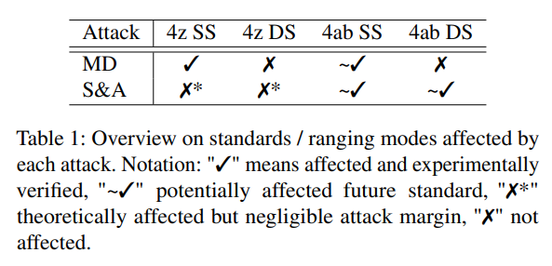
Introduction
Contributions
Discussion of the security implications of clocks
CFO and SFO
Two novel attacks against UWB ranging
Mix-Down (MD) attack
Stretch-and-Advance (S&A) attack
Practical evaluation of MD
Countermeasure against Stretch-and-Advance

Slide 11
Related Work
Distance bounding protocols [9, 26, 45]
Practical realizations of distance bounding protocols based on wireless ranging have been proposed (e.g., based on UWB [39] or NFC [21])
Time-of-Arrival integrity
Clock imperfections
[9] Stefan Brands and David Chaum. Distance-bounding protocols (extended abstract). In Tor Helleseth, editor, Advances in Cryptology - EUROCRYPT ’93,Workshop on the Theory and Application of of Cryptographic Techniques, Lofthus, Norway, May 23-27, 1993, Proceedings, volume 765 of Lecture Notes in Computer Science, pages 344–359. Springer, 1993.
[21] Gerhard P. Hancke and Markus G. Kuhn. An RFID distance bounding protocol. In First International Conference on Security and Privacy for Emerging Areas in Communications Networks, SecureComm 2005, Athens, Greece, 5-9 September, 2005, pages 67–73. IEEE, 2005.
[26] Marc Kuhn, Heinrich Luecken, and Nils Ole Tippenhauer. UWB impulse radio based distance bounding. In 7th Workshop on Positioning Navigation and Communication, WPNC 2010, Dresden Germany, 11-12 March 2010, Proceedings, pages 28–37. IEEE, 2010.
[39] Kasper Bonne Rasmussen and Srdjan Capkun. Realization of RF distance bounding. In 19th USENIX Security Symposium,Washington, DC, USA, August 11-13, 2010, Proceedings, pages 389–402. USENIX Association, 2010.
[45] Nils Ole Tippenhauer, Heinrich Luecken, Marc Kuhn, and Srdjan Capkun. UWB rapid-bit-exchange system for distance bounding. In Proceedings of the 8th ACM Conference on Security & Privacy in Wireless and Mobile Networks, New York, NY, USA, June 22-26, 2015, pages 2:1–2:12. ACM, 2015.

Slide 12
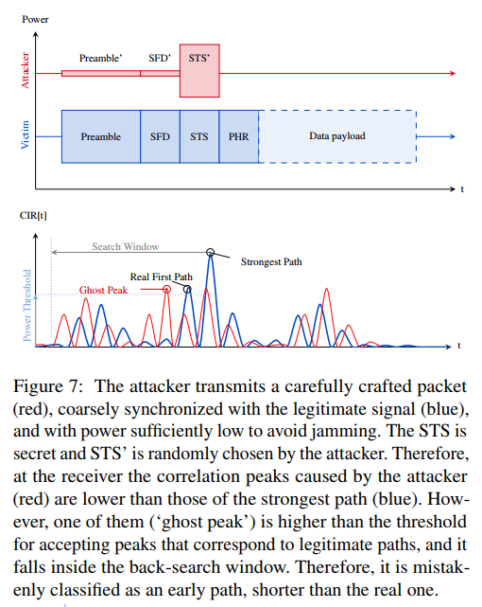
Related Work
Physical-layer attacks
Ghost Peak [27]
[27] Patrick Leu, Giovanni Camurati, Alexander Heinrich, Marc Roeschlin, Claudio Anliker, Matthias Hollick, Srdjan Capkun, and Jiska Classen. Ghost peak: Practical
distance reduction attacks against HRP UWB ranging. In 31st USENIX Security Symposium (USENIX Security 22), pages 1343–1359, 2022.

Slide 13
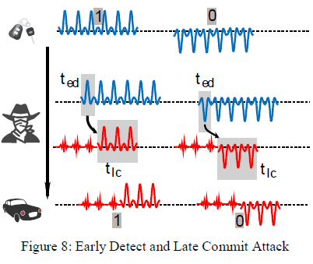
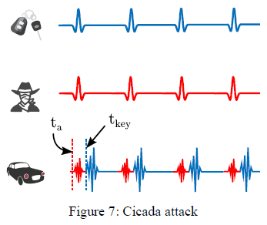
Related Work
Physical-layer attacks
Cicada [34, 35]
Early-Detect/LateCommit [33]
[33] Marcin Poturalski, Manuel Flury, Panos Papadimitratos, Jean-Pierre Hubaux, and Jean-Yves Le Boudec. Distance bounding with IEEE 802.15.4a: Attacks and countermeasures. IEEE Trans. Wirel. Commun., 10(4):1334–1344, 2011.
[34] Marcin Poturalski, Manuel Flury, Panos Papadimitratos, Jean-Pierre Hubaux, and Jean-Yves Le Boudec. On secure and precise IR-UWB ranging. IEEE Trans.Wirel. Commun., 11(3):1087–1099, 2012.
[35] Marcin Poturalski, Manuel Flury, Panos Papadimitratos, Jean-Pierre Hubaux, and Jean-Yves Le Boudec. The cicada attack: Degradation and denial of service in ir ranging. In 2010 IEEE International Conference on Ultra-Wideband, volume 2, pages 1–4, 2010.

Slide 14
Related Work
Time-of-Arrival integrity
Message Time-of-Arrival Codes (MTACs) [28]
Clock imperfections
Compensation techniques [13, 31]
Formulas described in 802.15.4z [3, 4] – standards
Algorithms for secure time synchronization [16]
[13] Igor Dotlic, Andrew Connell, and Michael McLaughlin. Ranging methods utilizing carrier frequency offset estimation. In 15thWorkshop on Positioning, Navigation and Communications, WPNC 2018, Bremen, Germany, October 25-26, 2018, pages 1–6. IEEE, 2018.
[28] Patrick Leu, Mridula Singh, Marc Roeschlin, Kenneth G. Paterson, and Srdjan Capkun. Message time of arrival codes: A fundamental primitive for secure distance measurement. In 2020 IEEE Symposium on Security and Privacy, SP 2020, San Francisco, CA, USA, May 18-21, 2020, pages 500–516. IEEE, 2020.
[16] Saurabh Ganeriwal, Christina Pöpper, Srdjan Capkun, and Mani B. Srivastava. Secure time synchronization in sensor networks. ACM Trans. Inf. Syst. Secur., 11(4):23:1–23:35, 2008.
[31] Dries Neirynck, Eric Luk, and Michael McLaughlin. An alternative double-sided two-way ranging method. In 13th Workshop on Positioning, Navigation and Communications, WPNC 2016, Bremen, Germany, October 19-20, 2016, pages 1–4. IEEE, 2016.

Slide 15
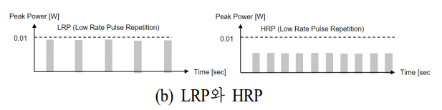
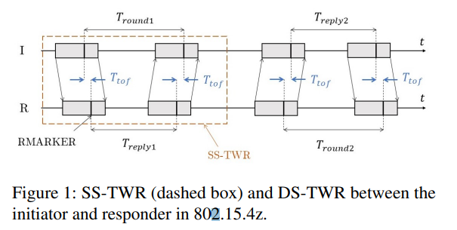
Background
UWB Secure Ranging
LRP and HRP
Two-Way ranging
Single-Sided Two-Way Ranging (SS-TWR)
Double-Sided Two-Way Ranging (DS-TWR)

Slide 16
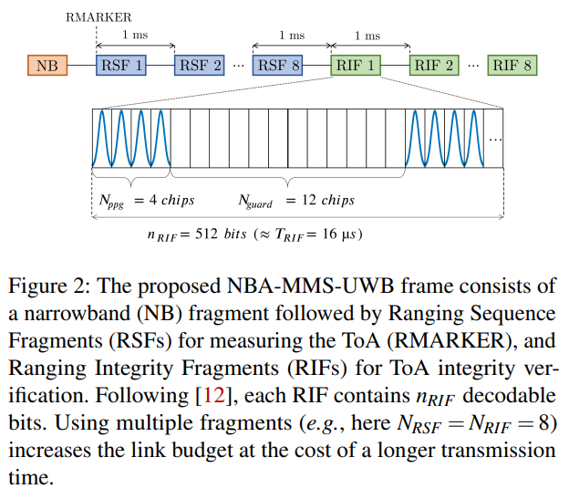
Background
802.15.4ab
Apple proposed Narrowband-Assisted Multi-Millisecond Ultra-Wide Band (NBA-MMS-UWB) ranging [14]
[14] Ersen Ekrem, Apple inc. More on NBA-MMS. https://mentor.ieee.org/802.15/dcn/21/15-21-0593-00-04ab-more-on-nba-mms.pptx. Accessed 2022-10-11.

Slide 17
The Mix-Down Attack (MD)
Threat Model
Dolev-Yao model
Attacker controls the wireless channel and can manipulate, block, inject, and eavesdrop on all wireless signals
Kerckhoff’s principle
Attacker knows everything about the victim’s devices except their cryptographic secrets

Slide 18
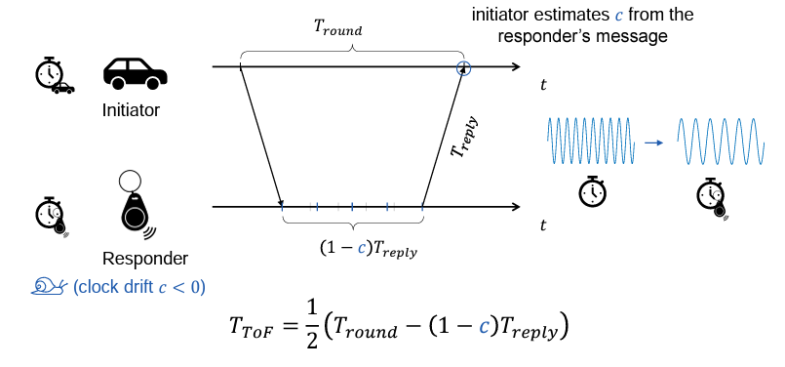

The Mix-Down Attack (MD)
General Idea
In SS-TWR, the attacker uses relative clock drift
$c = c_{resp} − c_{init}$measured by the initiator denotes the relative drift between the clocks of the two device

Slide 19
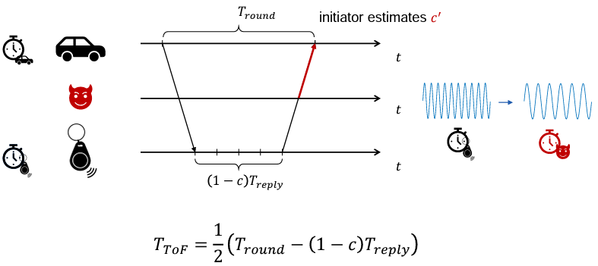

The Mix-Down Attack (MD)
General Idea
We can express the result of the attack as

Slide 20
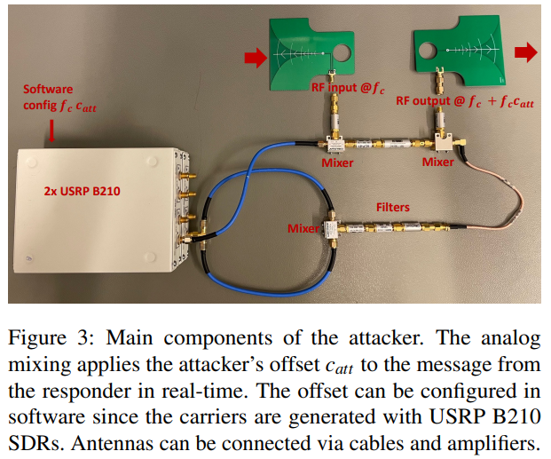

The Mix-Down Attack (MD)
Experimental Evaluation
Attacker: We implement our attack with a simple analog circuit consisting of off-the-shelf RF components
A mixer to convert it down to an intermediate frequency of 1.6 GHz, and another mixer to convert it up to the shifted carrier $f_{c}+f_{att}$
MD attacker is built of simple off-the-shelf components and two software-defined radios
Two Qorvo DWM3000EVB board
SDK [18]

Slide 21
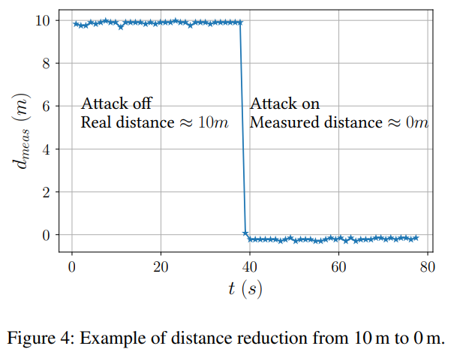
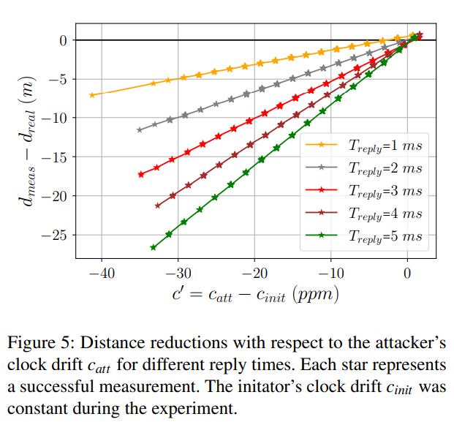
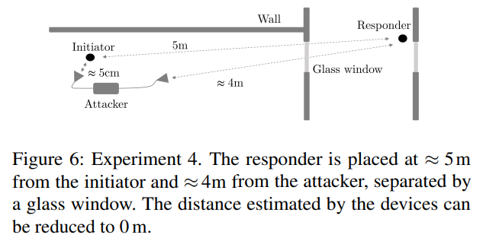
The Mix-Down Attack (MD)
Experimental Evaluation

Slide 22
The Mix-Down Attack (MD)
Summary Mix-Down
Impact: Mix-Down only affects Single-Sided Two-Way Ranging (SS-TWR)
Most (security-sensitive) applications use Double-Sided Two-Way Ranging
But: The upcoming standard IEEE 802.15.4ab seems to use SS-TWR as a default
Countermeasures: No silver bulletin sight
The carrier frequency cannot be cryptographically protected
Clocks drift naturally, e.g., due to changes in temperature
Exchanging clock drift estimations? Attacker can manipulate clock speeds in both directions
Alternative: Double-Sided Two-Way Ranging (but beware of Stretch-and-Advance!)

Slide 23
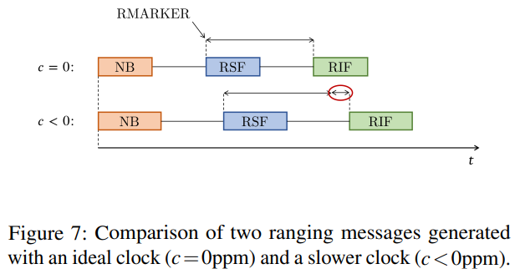
Stretch-and-Advance (S&A)
General Idea
Attacker injects a specially crafted ranging message, which is advanced (i.e., it reaches the receiver before the genuine one) and stretched in time
Because of the stretching, the attacker gains enough time to learn and replay the unpredictable RIF bits from the legitimate transmitter
NBA-MMS-UWB

Slide 24
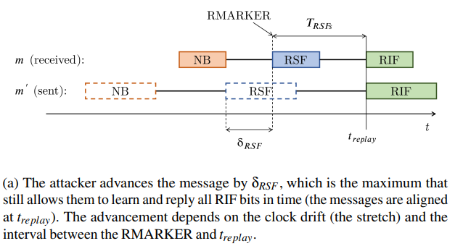

Stretch-and-Advance (S&A)
Attack Description
The attacker constructs m′ by first generating the NB and RSF
These parts to be deterministic
The attacker uses a clock with an artificial drift $c_{att}$ in the process
From $t_{replay}$ on, the attacker can learn and replay the signal and data from the real message m

Slide 25
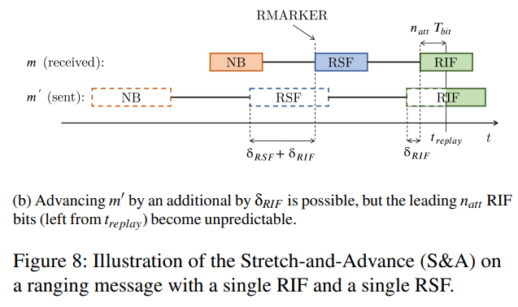

Stretch-and-Advance (S&A)
Attack Description
We note that the attacker could advance m′
However, this additional shift $δ_{RIF}$ might come at a cost: it moves $t_{replay}$into the RIF, which renders the leading RIF bits unpredictable for the attacker (→ BER)

Slide 26
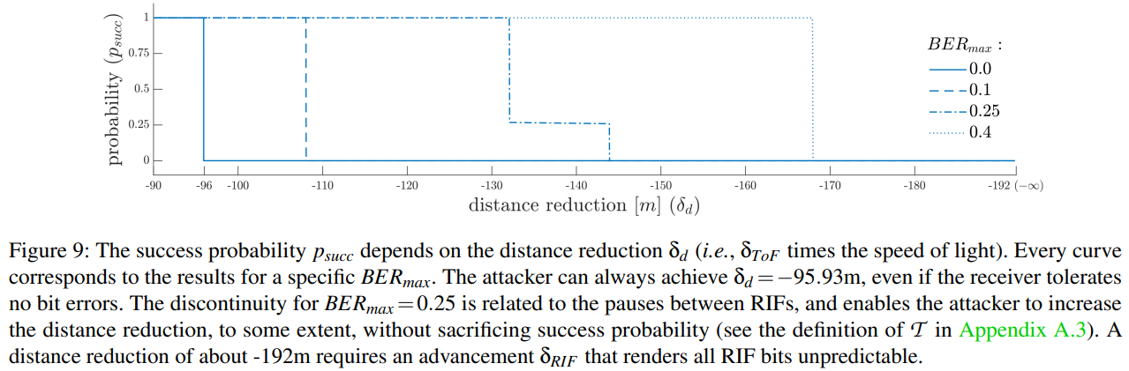
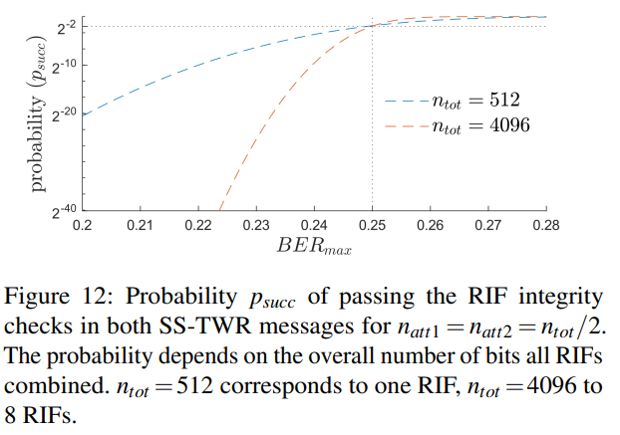
Stretch-and-Advance (S&A)
Evaluation

Slide 27
Stretch-and-Advance (S&A)
Countermeasure
The countermeasure we propose prevents S&A and cannot be bypassed if receivers set BERmax ≈0.2
We require their integrity to be cryptographically protected
Move the RMARKER’s position into the middle of the RIF

Slide 28
Conclusion
We provided an extensive analysis of the security impact of clock non-idealities and their compensation
Two over-the-air attacks, Mix-Down and Stretch-and-Advance
Our proposed countermeasures can defend against S&A, while MD does not have a straightforward solution
Our insights prove that the implications of physical layer aspects on ranging integrity are still not completely understood, and should be analyzed in the design of new standards and protocols

